Slide 1
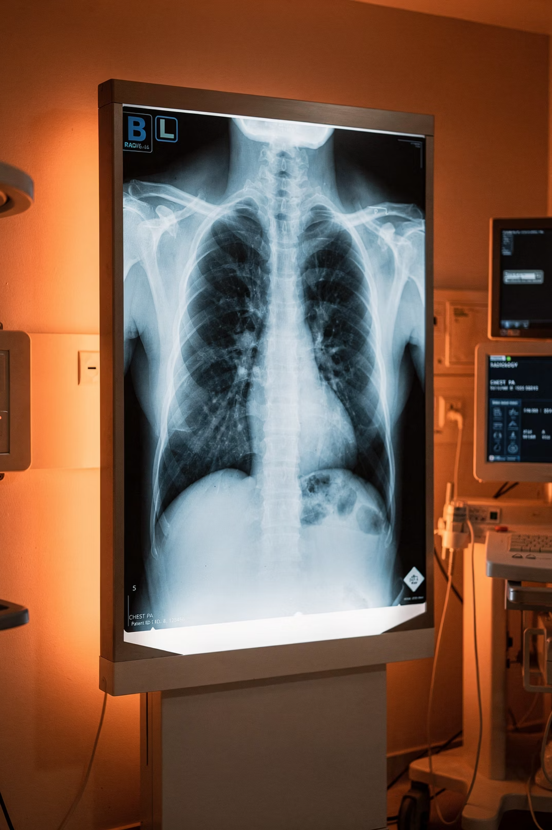
Chest X-Ray Pneumonia Detection
Capstone Project — Predicting Pneumonia from Chest X-Ray Images Using Machine Learning & Deep Learning

Slide 2
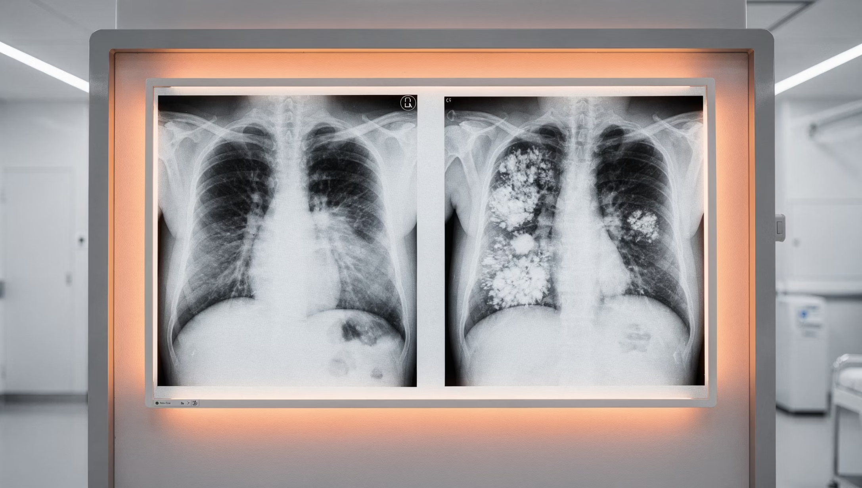
Background
Understanding the Problem
A normal chest X-ray shows clear lungs. Bacterial pneumonia shows focal lobar consolidation (e.g., right upper lobe). Viral pneumonia shows a diffuse interstitial pattern in both lungs.
Source: Cell, 2018 — Kermany et al.

Slide 3
Dataset Overview
5,863
2 Categories
Total chest X-ray images (JPEG)
Pneumonia vs. Normal
3 Splits
Train, Test, Validation folders

Slide 4

Data Source & Quality Control
Patient Cohort
Anterior-posterior X-rays from pediatric patients aged 1–5 years at Guangzhou Women and Children's Medical Center.
Quality Assurance
Low-quality scans removed. Diagnoses graded by two expert physicians, with a third expert reviewing the evaluation set.

Slide 5
Objectives
1
2
3
Manual Feature Engineering & EDA
Machine Learning (ML)
Computer Vision & Deep Learning
Train classical ML models on engineered features.
Pixel-based features and exploratory data analysis on X-ray images.
Apply CV and DL techniques for image classification.

Slide 6






Methodology
Feature Eng
EDA
ML Modeling
DL & CV
Web Deploy
Each phase builds on the previous — from raw pixel features through to a deployed web application.

Slide 7




Evaluation Metrics
Accuracy
Precision, Recall & F1
Overall correct predictions
Class-level performance balance
ROC-AUC
Confusion Matrix
Discriminative ability of the model
Detailed breakdown of predictions

Slide 8

Deliverables
Cleaned & Processed Dataset
Feature Engineering Pipeline
Trained ML Models
Deployed FastAPI Application
Final Report & Presentation

